Slide 1

Programming best practices and other stuff about the barbarians (the first day)

Slide 2
The first SW principle
“F**k you my code is better than yours”
Principle that is always valid no matter contexts, technologies or skills.
(2016 M. Merola)
SUBJECTIVE
MATTER

Slide 3

Goal
Best practices before starting
Errors while you are writing
Debugging the system

Slide 4

Before starting

Slide 5

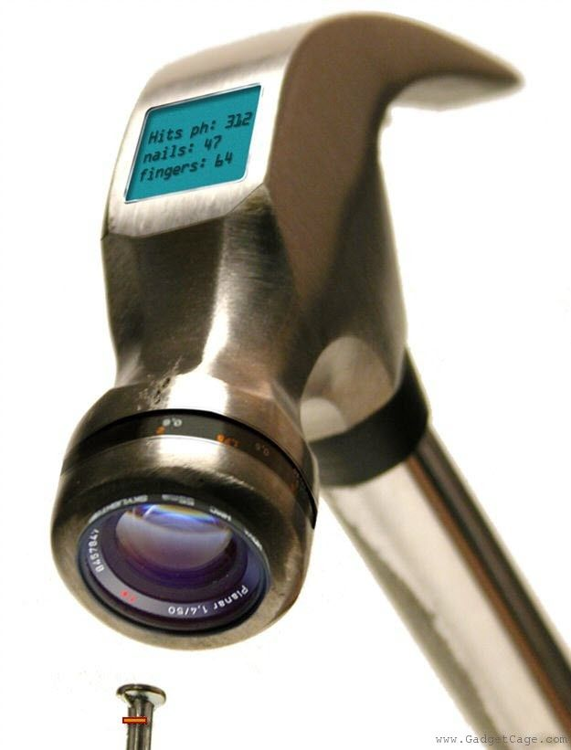
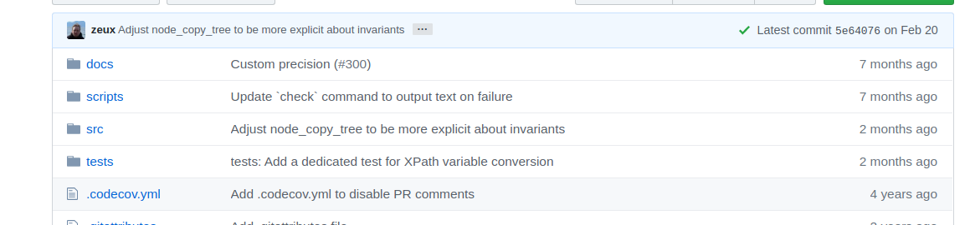
Tools and technology
The first step
Use proper tools for the job
My hidden hint
Check new technology with care​
Obsolete
No more support
Too new
The new version problem
ultimate choice for life

Slide 6




The right tools
example
Android development
Android is Java native!

Slide 7


The naming convention and the programming rules
The second step before start a new project is to choose (and to write) clear rules
Order first
Naming conventions
Programming rules
My hidden hint
https://google.github.io/styleguide/cppguide.html

Slide 8


The comments and the names
To comment or not to comment?
The key: choose right names
Difficult to maintain
Do not repeat
Note interesting by Joel:
the infamous Hungarian naming convention
https://www.joelonsoftware.com/2005/05/11/making-wrong-code-look-wrong/

Slide 9
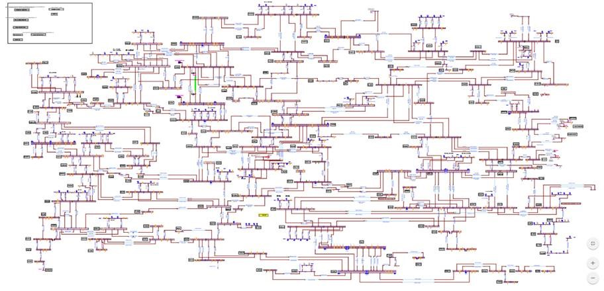
Software architecture
Mostly if you are on Agile group
Write down only the main part and the general lines of your software
Choose UML language to be generic
Be careful with class diagram
The architecture will change for sure in the next weeks
A too complex and rigid architecture won’t let you make the new changes
Prefer deployment diagram, and design at components level

Slide 10

Now is developing time

Slide 11

Code your own wheel
Close code wheel
Open code wheel (GitHub)
Invent my wheel
Check licenses
Check library lifetime and OS support
Check cost
Test functionality
Test code efficiency
Test code fault
Test and test
Check licenses
Check library lifetime and OS support
Test functionality
Test code efficiency
Test code fault
All is under my control (I hope)
Never use it, but you can learn
All is under my control

Slide 12
The Mongolian horde
Usually adding people to a delayed software project delays it even more
Some delay occur
PM add more programmers to the team
My hidden hint
Add people only if you have a good planning

Slide 13
The second SW principle
“Compila quindi funziona”
Again, principle that is always valid no matter contexts, technologies or skills.
(2007 L. Nardella)

Slide 14


Software quality I (compile so it works) The Coke problem(Siemens 2010, OEE market)
The sql string

Slide 15
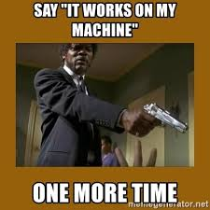
The third SW principle
“It works on my machine”
Again, principle that is always valid no matter contexts, technologies or skills.

Slide 16
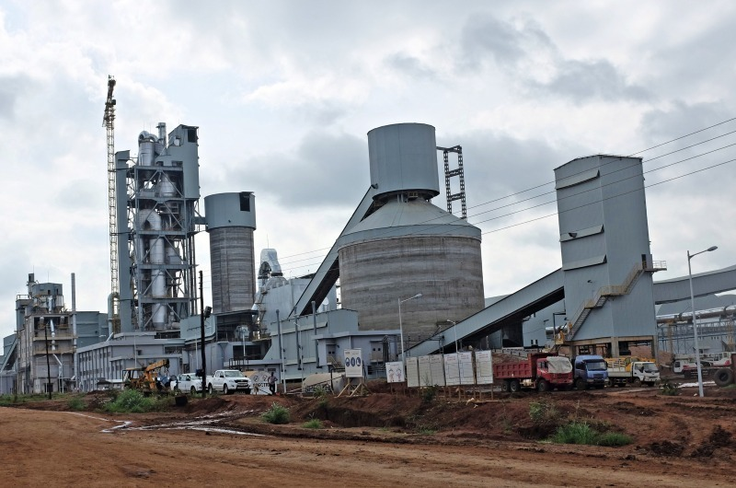
Software quality II (my machine) The delivery problem(Siemens 2012, OEE market)
dlls

Slide 17
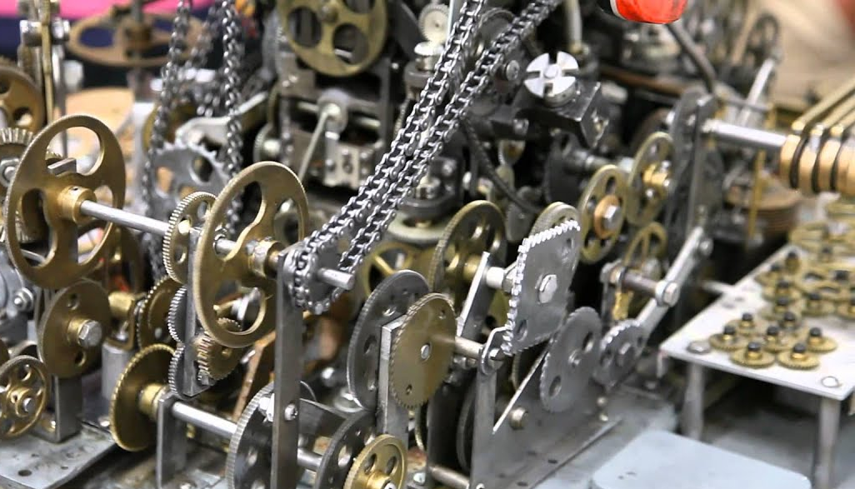

Always think generic (not only what you guess they can ask you in the future)
How can a banana fit in a gearbox?
Too late now
My hidden hint
Add or remove complexity?

Slide 18

Software quality III (be generic) The dynamometric wrench problem(Atlas-copco 2017)

Slide 19
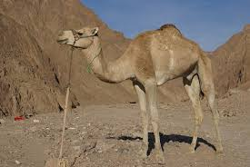
Refactoring (the code smells)
Why and When
To keep your code clean, the code smells like a wet camel
To save yourself time and money in the future
To reduce your technical debt (what is this?)
Why not
You have some new features to develop
You don't have (unit) tests
Never change a winning team
My hidden hint
Only if you can test the software

Slide 20
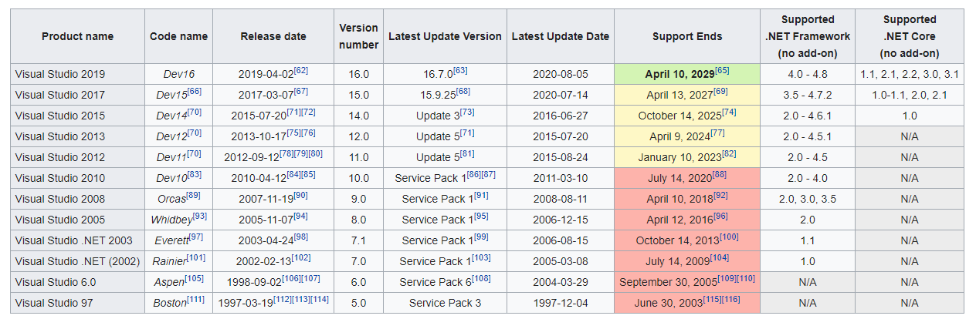
Example of a technical debit

Slide 21

Software quality IV (refactoring) The Tetra nightmare(Marconi 1998, the TETRA standard with Nokia)

Slide 22
Code optimization (Clear code first)
Optimization code rules(Michael A. Jackson):
Don’t do it.
(For experts only!) Don’t do it yet.
Why and When​
If you really have performance problems
If you want to add some bugs to your code
Why not​
For joke
Someone has already done this (stl,boost ...)
Be careful
Use the right tools, don't waste your time
Writing less code is not optimization!
Optimization vs Readability
​
My hidden hint
Check where to optimize

Slide 23

Software quality V(optimization) 100K Dollars(Ratioconsulta 2009, the telephone calls market)

Slide 24

Testing and Debugging

Slide 25

- Agile group collaboration vs Waterfall approach - Unit test (Java, C++) - Integration test - System test
My hidden hint
https://www.fingent.com/blog/collaborating-testers-and-developers-in-hybrid-agile-environment
Create mix test/devel group

Slide 26
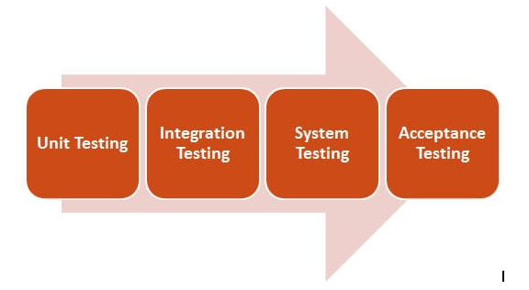
Test checklist

Slide 27
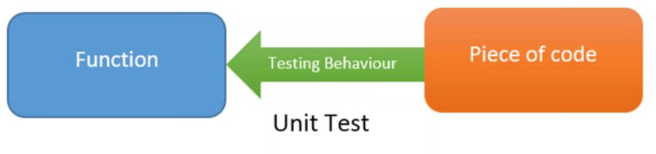
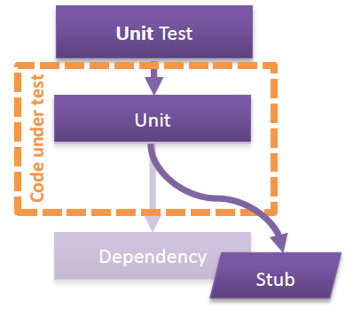
Mock and Stub
Unit test – Test the smaller part of a system

Slide 28

System test - Test a complete system
Testing a plane for breaks while landing

Slide 29

Automation test – repeatable, save and easy
Easy to use
Close to natural language as test case
Modular
Safe – each block is correct
Blocktest

Slide 30

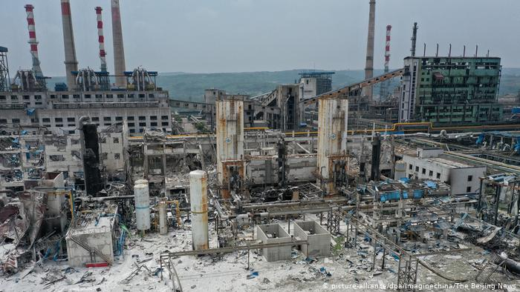
Debugging time
Debugger VS Logger
Simple development
Complex development
Production
My hidden hint
Learn to use good logging library

Slide 31
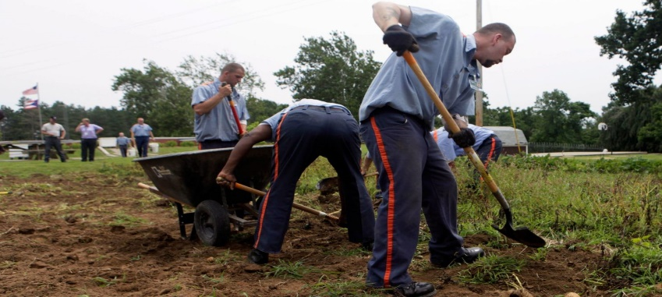
Practices, break the stones

